Slide 1


OPTICAL FABRICATION ENTERPRISE
Advanced Optical Solutions for Mission Readiness
Digital Freeform
Technology
PRECISION | PERFORMANCE | MISSION READY

Slide 2
WHAT ARE FREEFORM LENSES?
TECHNOLOGY OVERVIEW
VS
Traditional Lens Manufacturing
Digital Freeform Lenses
LEGACY PROCESS
DOFEMS STANDARD
Lenses made from fixed, pre-cast molds — no per-patient customization in the surfacing stage
CNC diamond-point surfacing — computer-numerically-controlled lathe crafts each lens to sub-micron precision
Limited customization — prescriptions constrained to standard incremental steps only
Custom-crafted to the individual's exact prescription — no approximations, no rounding to standard steps
Optical aberrations and peripheral distortions are common at the lens edges
Peripheral distortion dramatically reduced — clearer vision edge-to-edge across all gaze angles
Fully personalized to frame geometry, pupillary distance, and individual viewing habits

Slide 3


Slide 4
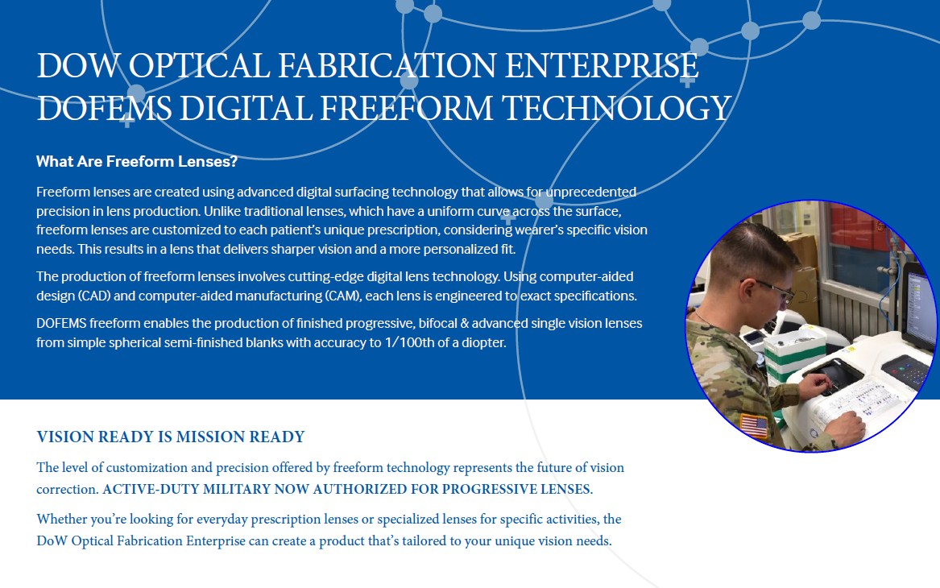

Slide 5
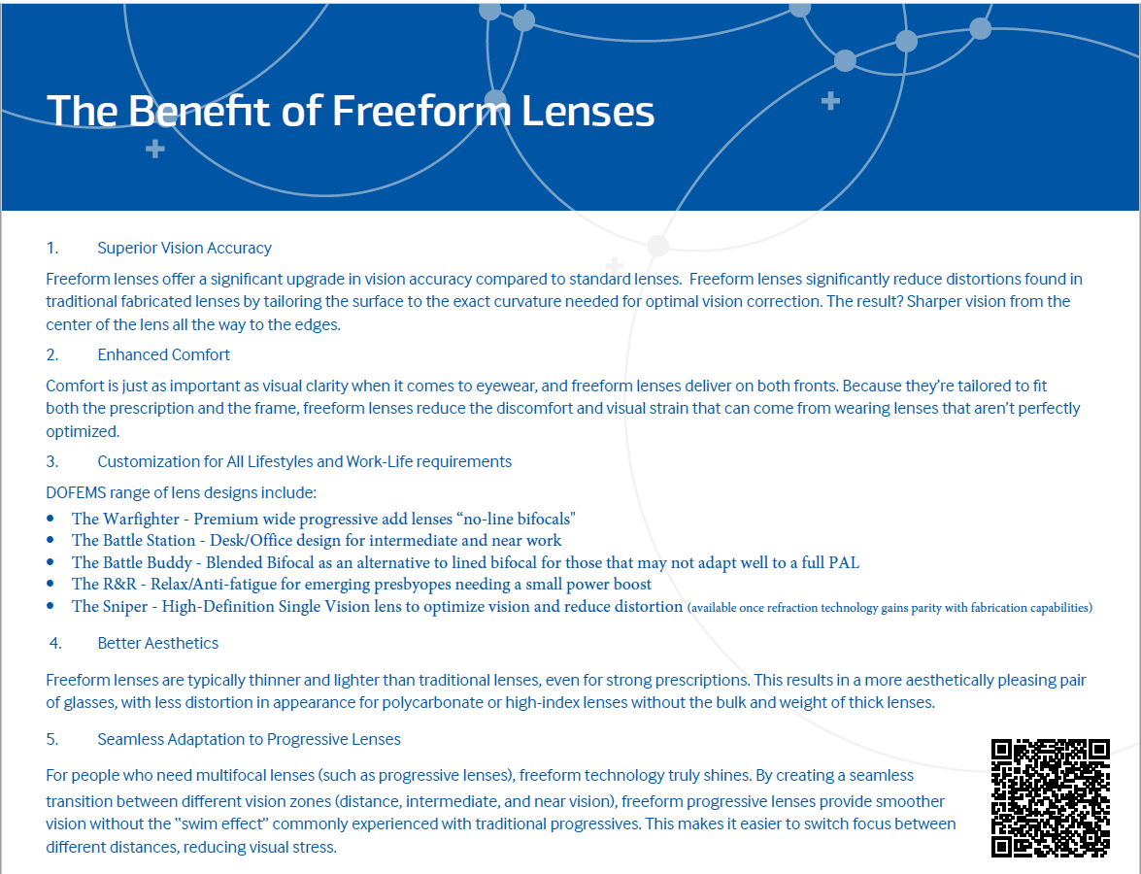

Slide 6
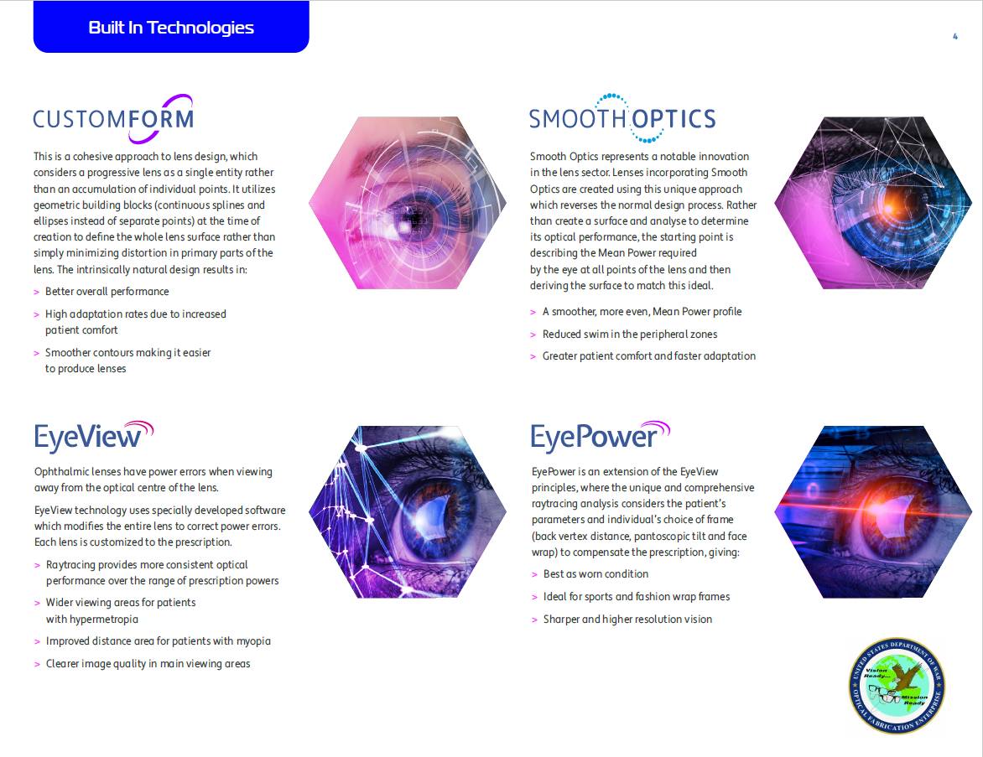

Slide 7
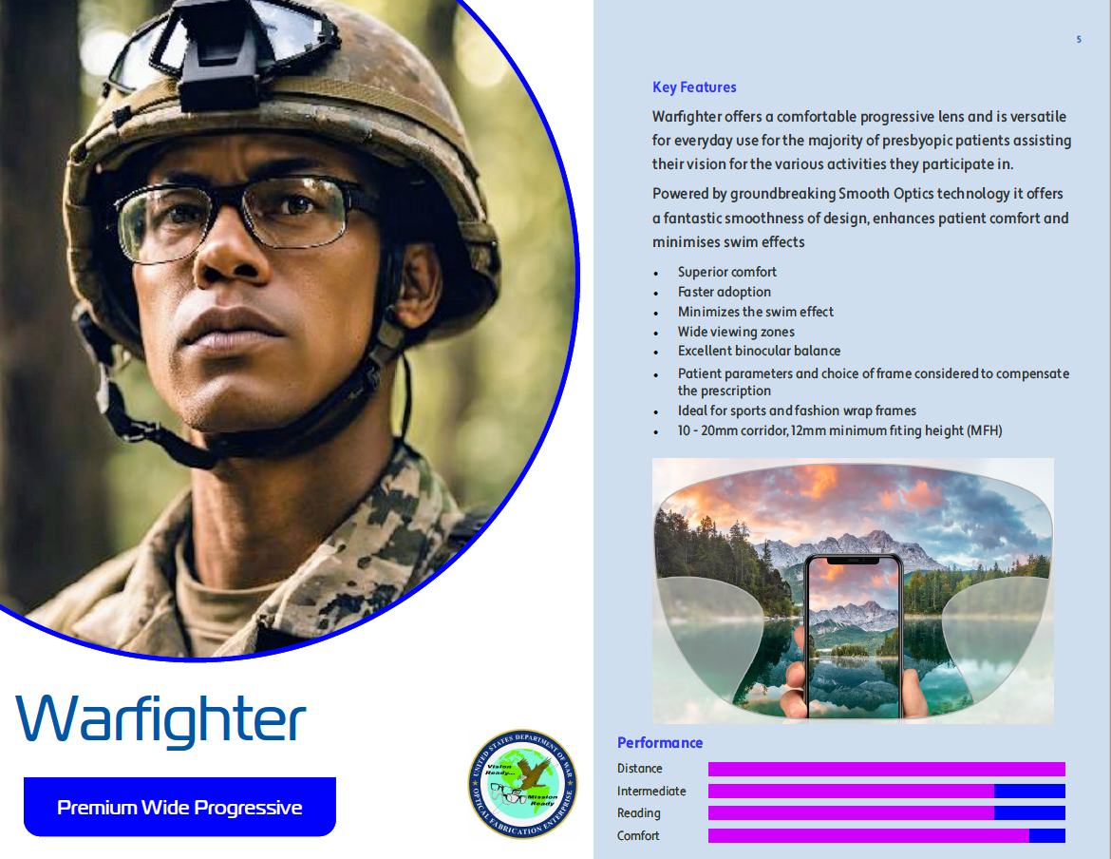

Slide 8
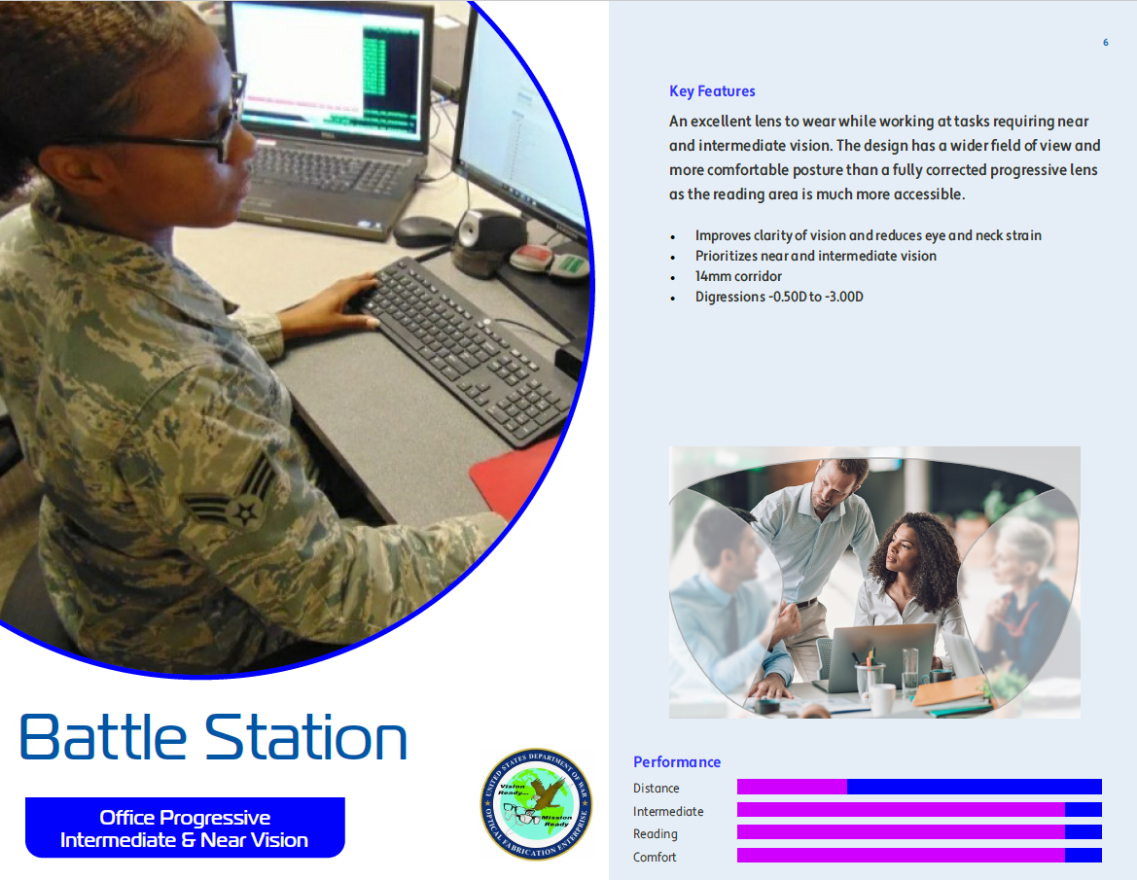

Slide 9
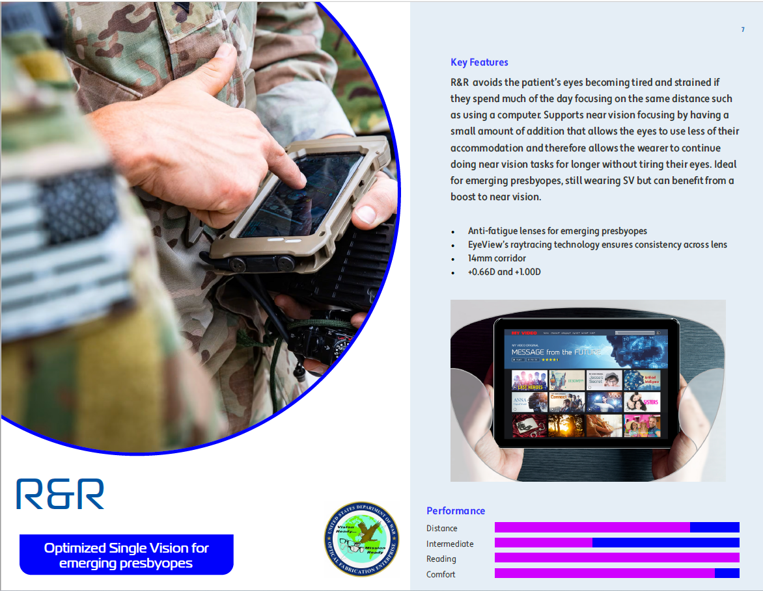

Slide 10


Slide 11
Freeform Progressive Lenses:
A Superior Solution
Progressive Addition Lenses benefit enormously from digital freeform surfacing technology.
Wider Clear Viewing Zones
Freeform PALs provide broader distance, intermediate, and near viewing corridors compared to conventional progressives — maximizing usable lens area.
Faster Visual Adaptation
Wider
VIEWING ZONES
Service members adapt to freeform progressives significantly faster than conventional designs — reducing downtime and improving operational readiness.
Faster
ADAPTATION
Individualized Corridor Design
The progressive corridor is custom-positioned based on the wearer's exact pupil height and frame measurements — no generic fitting assumptions.
Reduced Swim & Sway
360°
OPTIMIZED SURFACE
Peripheral distortion ("swim effect") is minimized, reducing disorientation during movement — critical for tactical environments.
Better Performance Across All Gaze Angles
Optical performance is consistent whether looking straight ahead or in peripheral gaze — engineered for the full range of warfighter visual demands.

Slide 12
BENEFITS FOR SERVICE MEMBERS
STANDARD LENSES
DOFEMS FREEFORM LENSES
Conventional approach
Digital precision advantage
Limited prescription accuracy — steps of ±0.12D leave residual optical error
Sub-±0.01D prescription precision — over 10× more accurate than conventional surfacing .
Peripheral distortion under stress — swim & sway effect degrades situational awareness
Clear vision edge-to-edge — every point of the lens optimized, distortion eliminated across the full field
VS
Slower adaptation for progressive wearers — extended acclimation periods in the field
Rapid adaptation in the field — freeform design dramatically reduces acclimation time for progressive wearers
Thicker, heavier lenses — reduced comfort and increased fatigue during extended wear
Thinner, lighter, more comfortable — CNC surfacing reduces edge & center thickness by up to 20%
One-size-fits-all design — no personalization for frame, PD, or individual visual habits
Fully personalized optical system — Rx, frame geometry, PD, vertex distance, and gaze habits all integrated
Every lens is unique — crafted to the individual warfighter's visual system.

Slide 13
DEPARTMENT OF WAR · OPTICAL INNOVATION
Equip our Service Members
with enhanced vision
Digital Freeform Technology — Setting the Standard for Dow Optical Care
1
CONSULT YOUR INSTALLATION LAB
Consult your installation's certified DOFEMS optical lab for eligibility and ordering information.
2
ORDER THROUGH CERTIFIED FREEFORM PROCESS
Ensure all progressives and complex prescriptions are ordered through the DOFEMS-certified freeform process.
CERTIFIED DOW OPTICAL PROGRAM
Digital Freeform · Sub-0.01D Precision · Mission Ready
3
CONTACT NORA CUSTOMER SERVICE
Contact Nora Customer Service for training and implementation resources.
PRECISION VISION
DOFEMS
|
DOW Optical Standards

Slide 14

Equipping our Service Members with
“The Sight to Fight”
PRECISION | PERFORMANCE | MISSION READY

